Slide 1

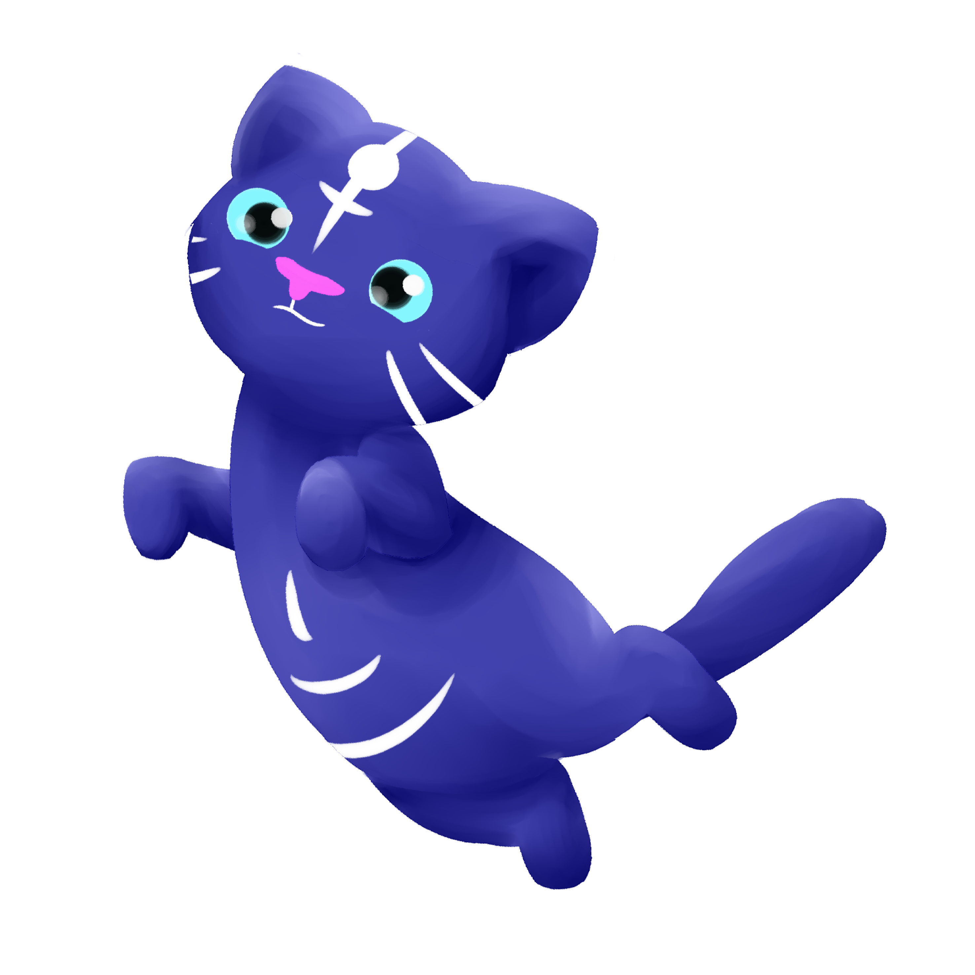

Level 6, Group 6: Charlie Crew, George Flude, Alexander Polley and Callum Walsh.

Slide 2


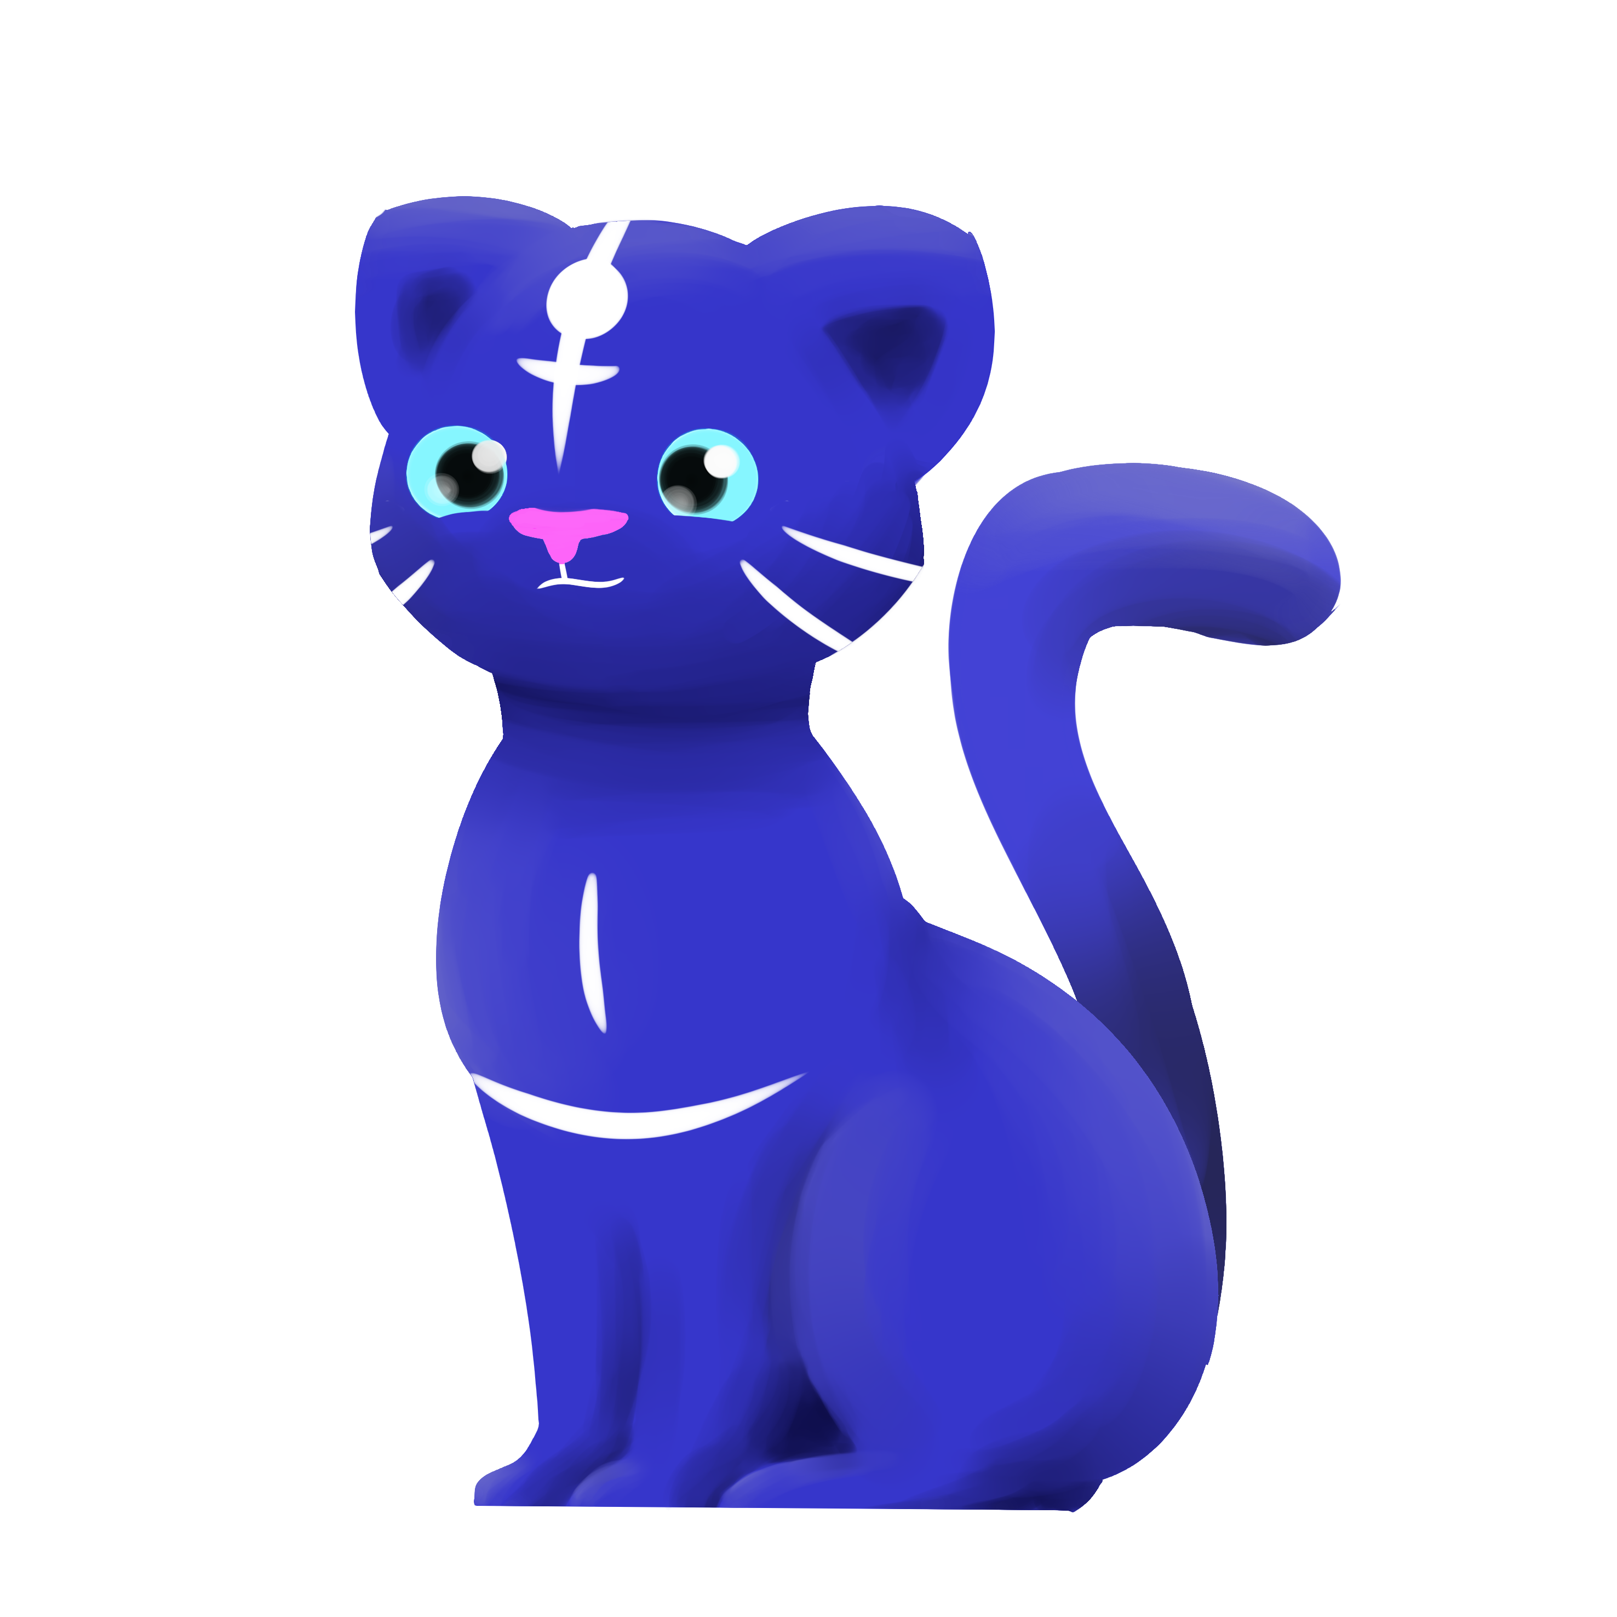
Our brief
Create a casual game that uses minimal input.

Slide 3
Psychograph
Name: Maarii
Age: 48
Occupation: Admin/Sales
Marital Status: Married
Likes:
Chocolates
Toffees
Biscuits
Cats
Dogs
Horses
Dislikes:
Insects
Large Dogs
Scaled Creatures
Heights

Slide 4

Game Loop
Tap
Reward
Colour

Slide 5
Game Footage

Slide 6
What our players liked
Found the art to be visually pleasing.
Enjoyed having to interact with the Cat companion to open the games menu.
Enjoyed the visual feedback that would happen when painting an object.
Enjoyed the simplicity of the controls, weren’t hard to grasp how to play.

Slide 7
What our players disliked
Would have like the Cat companion to have more of a role.
Found certain objects were to small to colour.
Would of liked to have more of a colour selection.
Would of liked to have the ability to Zoom-in closer.
Would of liked to been able to paint more than one single island.

Slide 8
What we thought went well

Slide 9
What could have gone better

Slide 10
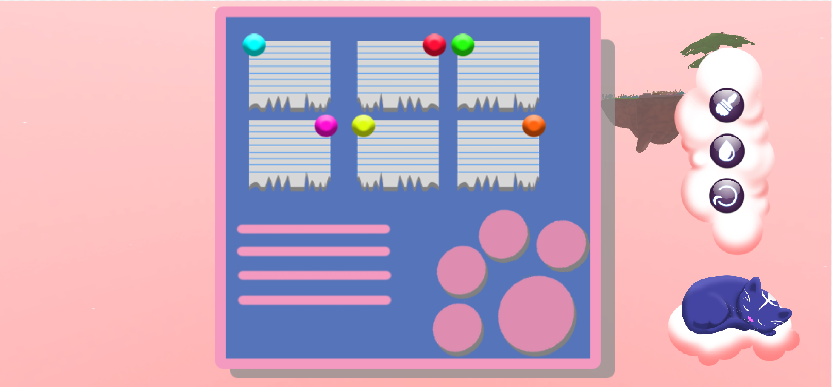
If we were to continue

Slide 11
If we were to continue

Slide 12
Management statistics

Slide 13
Management statistics

Slide 14
Any questions?

